Slide 1

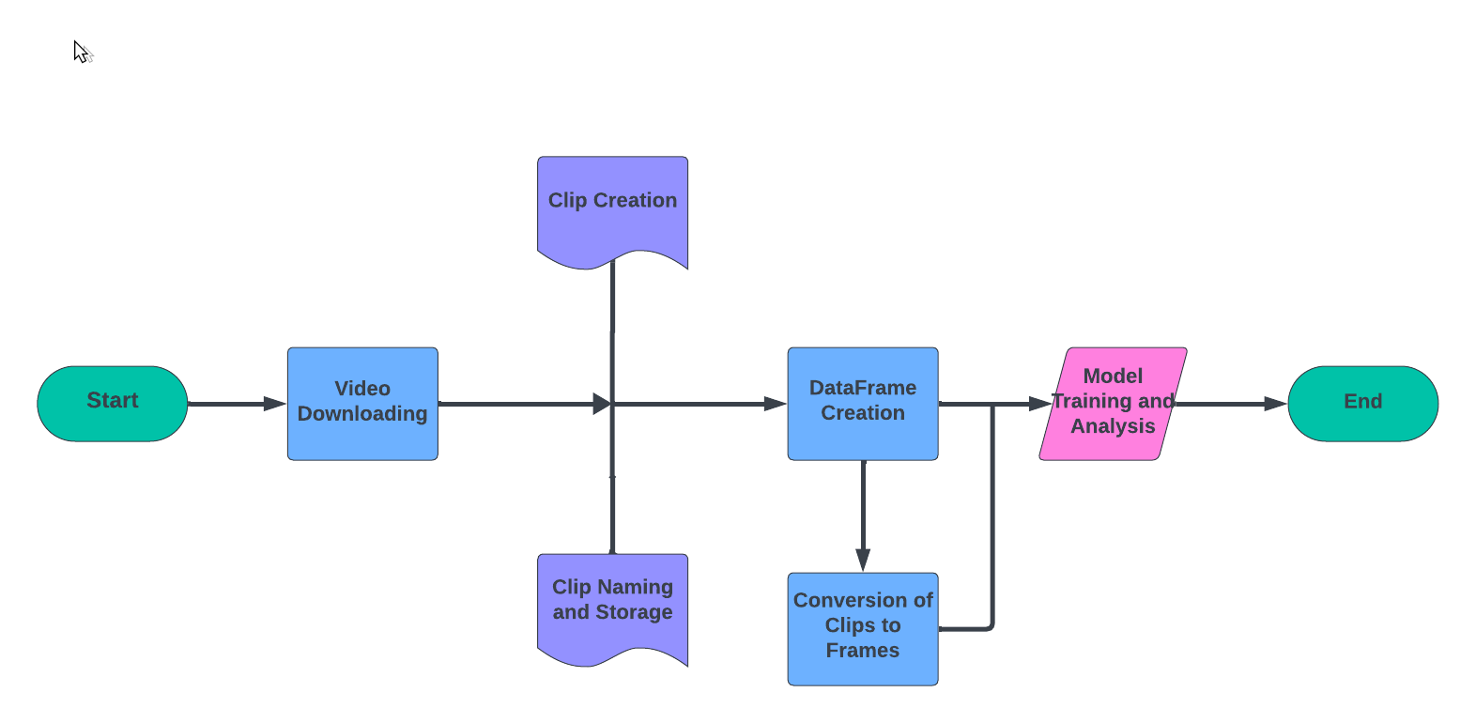
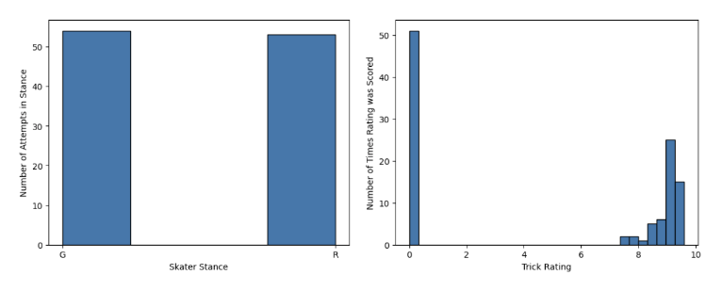

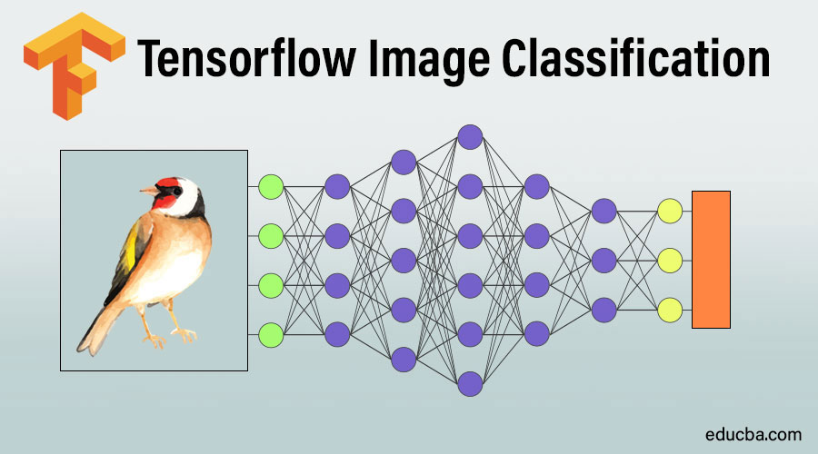
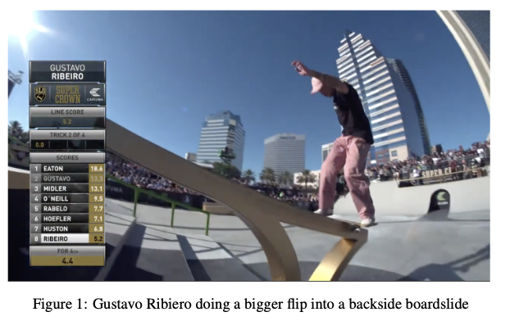
SkateNet: A Data Set On Competition Skating
Mason Taylor
INTRODUCTION
PIPELINE
RESULTS
Before the addition of street skating to the Olympics, Street League Skating, or SLS, has been the premier street skating competition of the world. The competition consists of
:
Two 45-second runs
Five best trick attempts
Attempts are generally scored on complexity and variety of tricks.
They are score on a 10 point scale
A data set was created, SkateNet, that can be used to train video recognition Artificial Intelligence to accurately classify and rate trick videos like a professional judge would in a street competition. There were three steps in producing this data set.
First Supercrown, the championship of SLS, videos were downloaded off of SLS's YouTube channel
Next, best trick attempts were clipped from the downloaded YouTube videos.
Finally, the accuracy of MoViNet's a2 model's predictions was tested on a random sample of the clips.
Skating | Bobsled | Long Jump | Ski Jump | Triple Jump | Face Planting
85.7% | 1.9% | 1.8% | 1.6% | 1.2% | 1.2%
The Top 6 Results of Testing the Model on the Data Set
First, videos of the Supercrown were downloaded from SLS’s YouTube Channel
Next, clips of best trick attempts were made and classified based on stance, tricks attempted, and rating
Then, the clips were stored in a DataFrame and converted into frames so they could be input to the model
Consisted mainly of converting color values to a 0-1 scale instead of 0-255
Finally, the model classified a random sample of the clips and the results were analyzed
Skater Stance and Trick Rating Distributions
To test the validity of the data set, a random sample of 30 was classified using MoViNet’s a2 model. It successfully classified 85.7% of the videos as skating.
Long jump, triple jump, and ski jump can all possibly be explained because the videos consist of someone in the air in front of a crowd.
Bobsledding can be explained by how skaters slide on their backside on failed attempts on the white concrete of the venue
Face planting can also be explained by failed attempts resulting in skaters face planting
The bimodal distribution of skate stances makes it very easy to classify
The bimodal distribution of ratings makes it hard to rate videos on a 10 point scale
MODEL
DATA
Video | Rating | Stance | All Tricks | First Trick | Second Trick | Third Trick | Location | Year
Bigger Flip + BS Board-slide 9,1 | 9.1 | G | Bigger Flip + BS Board-slide | Bigger Flip | BS Board-slide | N/A | Jacks-onville | 2021
easily modifiable
CONCLUSION
The biggest limitation with this project is the lack of contextual skills the model has in comparison to a person.
A majority of the tricks completed in a skating competition consist of two tricks.
The first one is done in the air, while the second one is done in a grid trick.
The rating of a trick is based on these tricks in combination.
There is no way to split up the scoring between the two tricks, so it makes it very hard to rate tricks individually.
Instead of assessing tricks on a 0-10 scale and not using anything between 0 and 7, the scale could be adjusted to be from the lowest scored trick to 10.
This would allow there to be an actual distribution, since the zeros from missed attempts would not be separated from the made attempts.
The Videos were classified using MoViNet’s a2 model by TensorFlow. It is optimized to work on mobile devices. This is good, because it allows video classification on devices without powerful hardware. The model is trained on over 600 individual movements. It takes in frames of the video as input and classifies them separately. After receiving all of the frames, it gives a confidence rating for the top 5 classes. The model can be fine tuned to change what classes it identifies, allowing the ability to possibly classify trick combinations in future work.
The model is given a video as frames and a label it should associate the video with
Next, it places the video into a group under the label it was given
Finally,iIt makes its own connections between videos in the same group
Gustavo Ribiero attempting a Bigger Flip into a Backside Boardslide
With the Corresponding Entry in the DataFrame
Each entry in the DataFrame contains the name of the video, rating, stance of the skater, all of the tricks completed, the first trick, second trick, third trick, the location of the event, and the year completed. The columns trick2 and trick3 can have N/A values because some attempts only consist of one or two tricks. The example entry in the Data Frame above is for the figure below it.

